Slide 1


Slide 2






ALIF
The First
An Intelligent HR Assistant

Slide 3
Our Team
Muqeet A.
Abdullah A.
Usman Ali
Sadia J.
Abdullah F.
Member
Member
Supervisor
Scrum Master
Member

Slide 4
Extracted from proposal
Labor force growth
Problem Statement
Current HR processes are inefficient, with qualified candidates often overlooked due to manual resume screening and time-intensive interview processes. While existing AI solutions are limited to basic chatbots, there's a need for human-like interaction and end-to-end systems that can handle multiple HR tasks efficiently and build user trust.
(Further details are added into Proposal)

Slide 5
Opportunities and Challenges
70%
30%
15%
47%
Candidates are hired due to favoritism
Fresh graduates in IT sector find a job within first 6 months
Annual growth is observed in IT and digital services
Increase in demand for skilled HR professionals

Slide 6
Recruitment Metrics
1.84M +
1.51M +
173M +
Job openings / year
Employees hired / year
Applications processed H1-2024
> 1 Month
30B +
1/2 Hour
Average hiring process / job
Spent in HR salaries / year
Average interview time

Slide 7
ALIF
Introducing

Slide 8
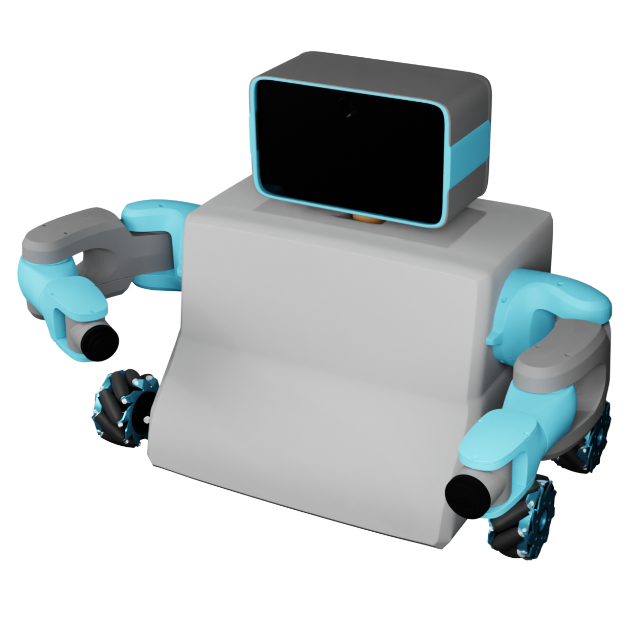
ALIF
An Intelligent HR assistant that can:
Screen & analyze resumes
Take interviews
Generate interview reports
Interact with candidates
Observe its surroundings
Show gestures and expressions

Slide 9
The Adoption and Effect of Artificial Intelligence on Human Resources Management, Part A
Emerald | DOI: 10.1108/978-1-80382-027-920231015
AI-HRM: Artificial Intelligence in Human Resource
Management: A Literature Review Journal of Computing and Communication | Vol.2 , No.2 , PP. 1-7 , 2023
Literature Review
ALIF promotes Human-Like Interaction
ALIF incorporates following features to improve user trust and engagement:
Expressive faces
Voice communication
Body language
These feature go beyond the typical virtual assistants seen in HR automation systems by aligning more closely with human interaction needs.

Slide 10
Artificial Intelligence Reshaping Human Resource Management : A Review
IEEE | DOI: 10.1109/ICATMRI51801.2020.9398420
The Adoption and Effect of Artificial Intelligence on Human Resources Management, Part A
Emerald | DOI: 10.1108/978-1-80382-027-920231015
Literature Review
ALIF has Modular Design for Versatility
The plug-and-play arm design is a novel approach for scalability and flexibility.
While existing systems might focus on fixed functionalities, ALIF's ability to adapt its tasks (e.g., HR, tailoring assistance) is a significant innovation.

Slide 11
AI-HRM: Artificial Intelligence in Human Resource
Management: A Literature Review Journal of Computing and Communication | Vol.2 , No.2 , PP. 1-7 , 2023
Literature Review
End-to-End HR System and Inter-Domain Integration
Unlike systems that focus solely on resume screening or candidate recommendations, ALIF offers end-to-end HR automation including:
Resume analysis
Physical interaction
Interviewing (both technical and personality-based)
Report generation

Slide 12

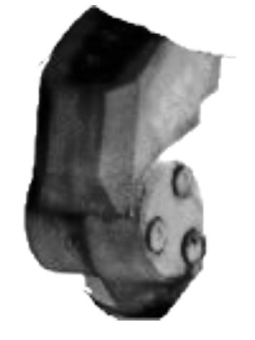
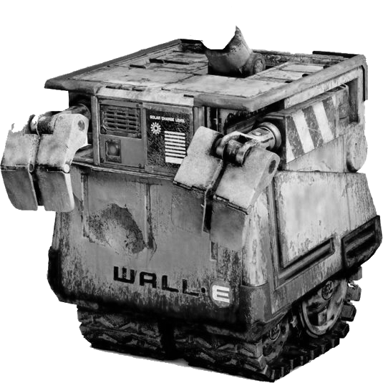

Motivation
Our motivation mainly comes from the fact that the industry is facing such situations.
We are motivated to present our solution as a robot which not only can be trained to do interviews but can also be trained on general tasks for other industries.
We propose to revolutionize the industry with our generalized system which can have its use-case in multiple domains.

Slide 13


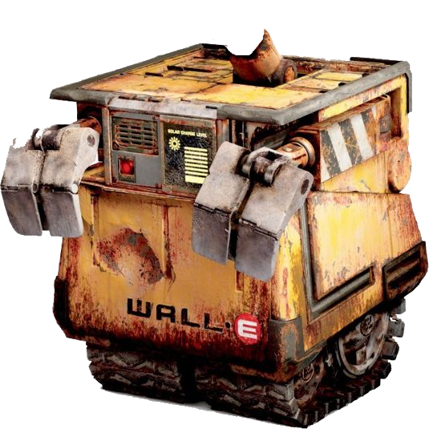
Motivation
Wall-E
Wall E is an AI robot from the Pixar movie which ignited our motivation

Slide 14

Motivation
EMO Bot
EMO an AI pet robot designed by LivingAI ignited our motivation

Slide 15

A look at the
Software
Structure

Slide 16

Software
The main idea
of ALIF
System
It will be taking audio, video input and data from sensors to create a request in specified structure in every IPO cycle. We will use a Blackbox system that will respond to user query, generate facial expressions and limbs movement.

Slide 17








Software
Procedure
Input
Processing
Output

Slide 18






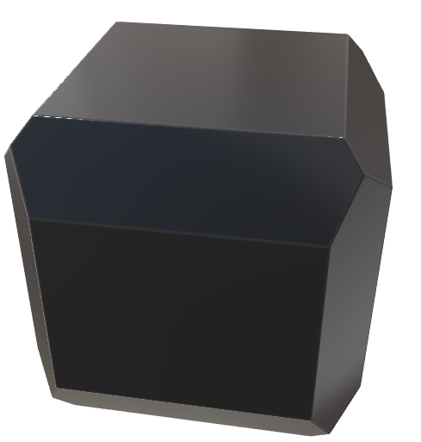
Input Flow
STT
Mic
Text
CV
Camera
JSON
Request
JSON
Sensors

Slide 19



Output Flow
TTS
Text
Speaker
Face
JSON
Display
Response
JSON
Hardware

Slide 20
Hardware
Structure
Of ALIF
The body of ALIF will be 3D-printed and will consist of a base (with mecanum wheels), the torso will hold battery and microcontroller. Arms with servos will be attached to both sides and there will be a face with display and camera embedded

Slide 21
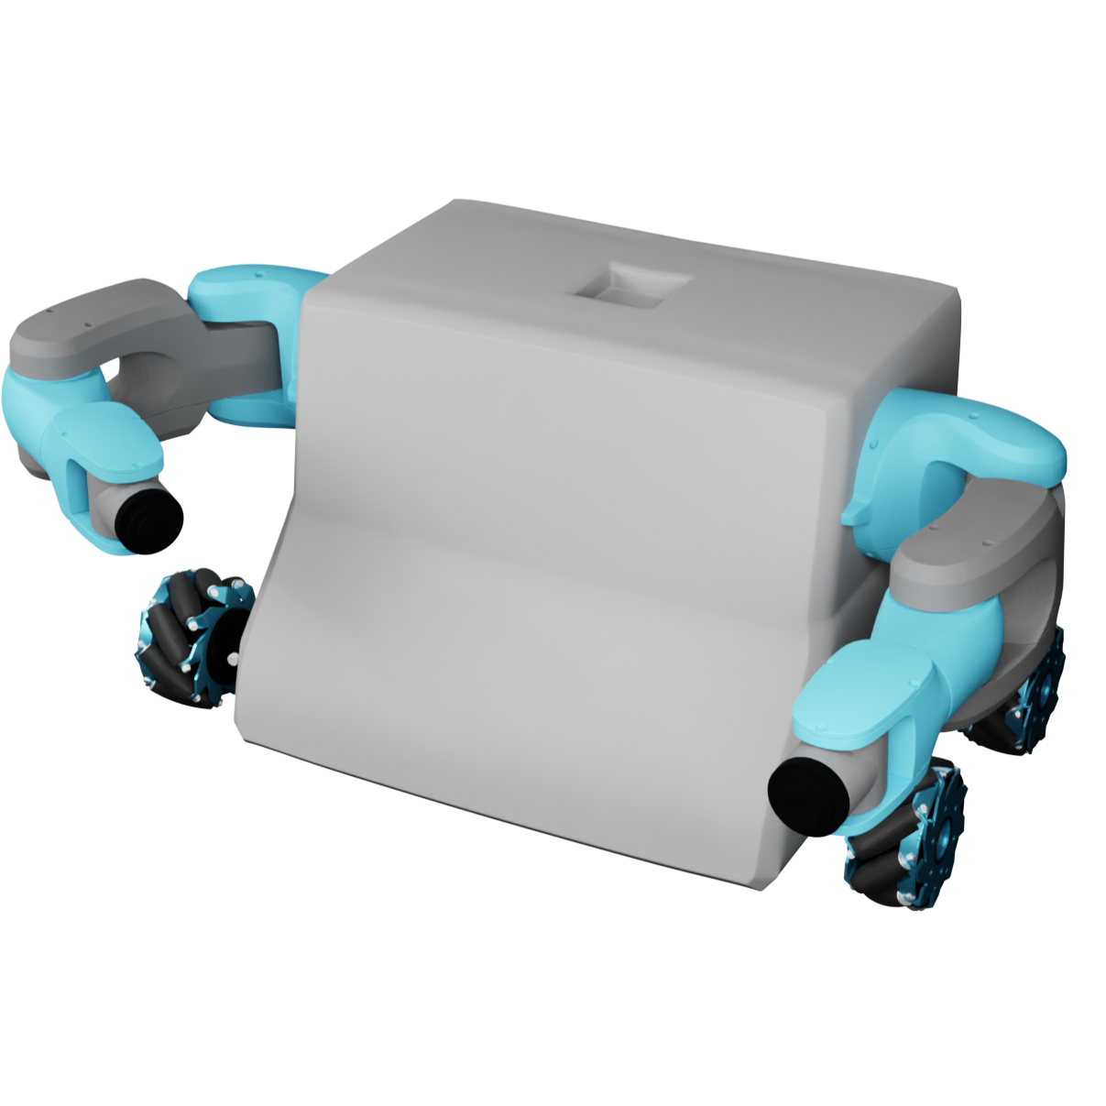
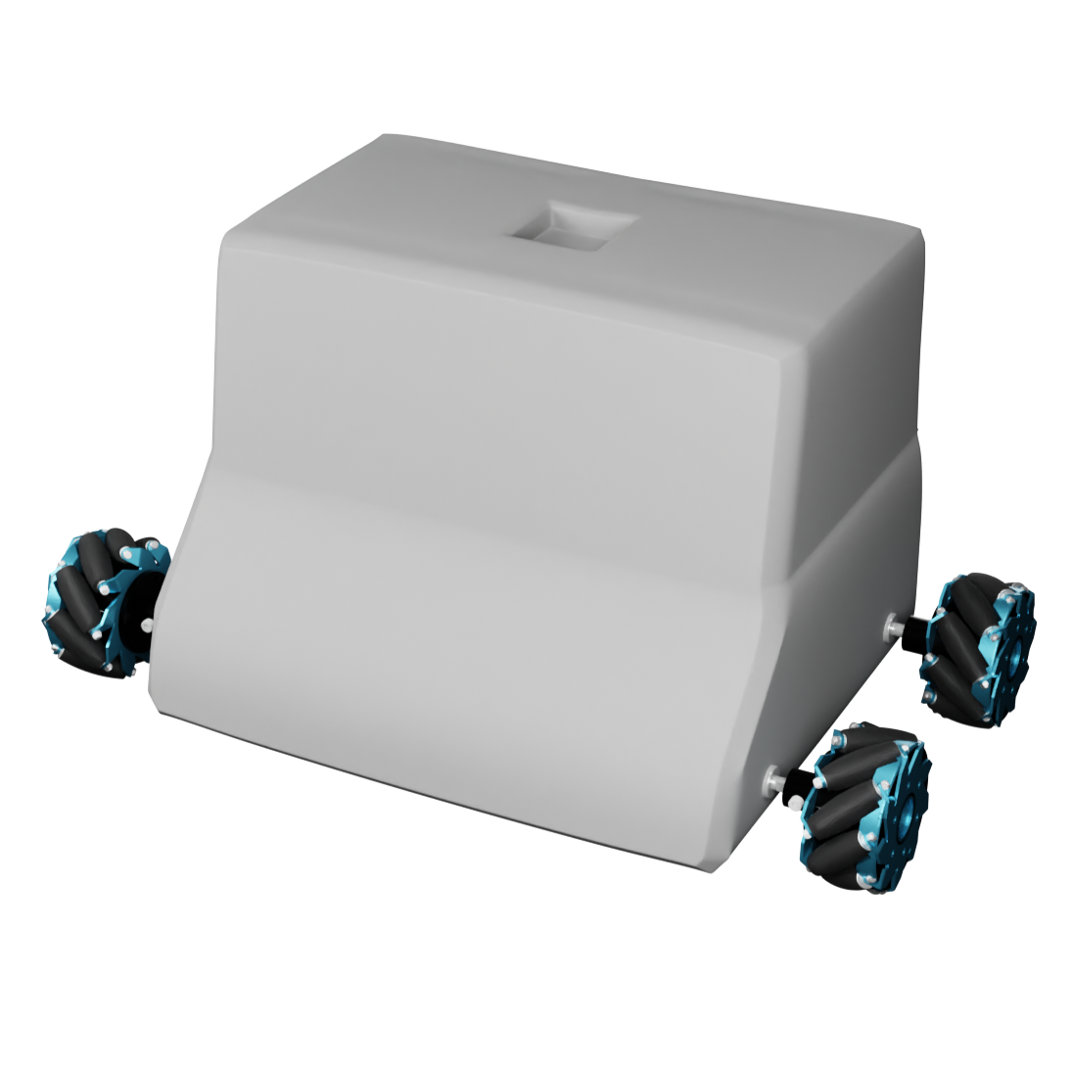
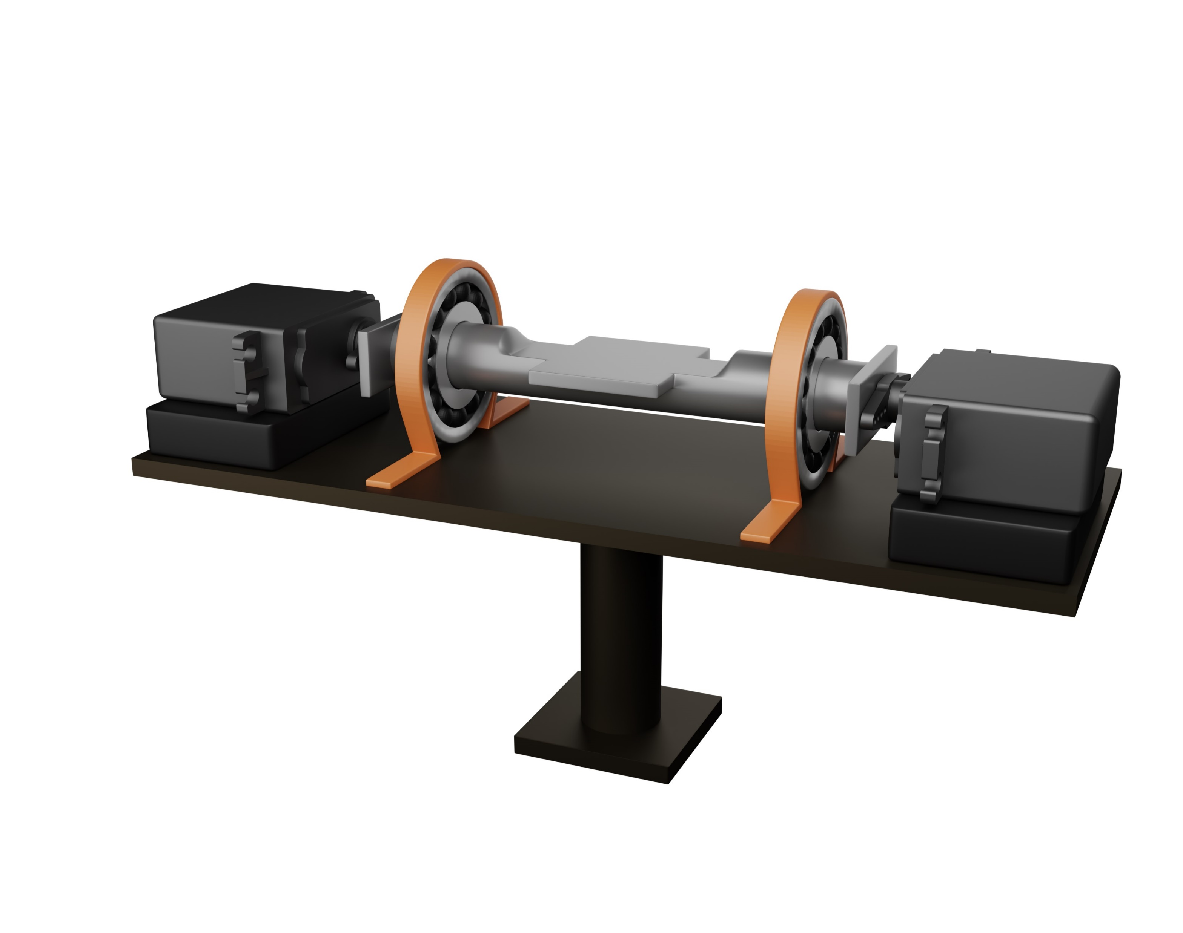
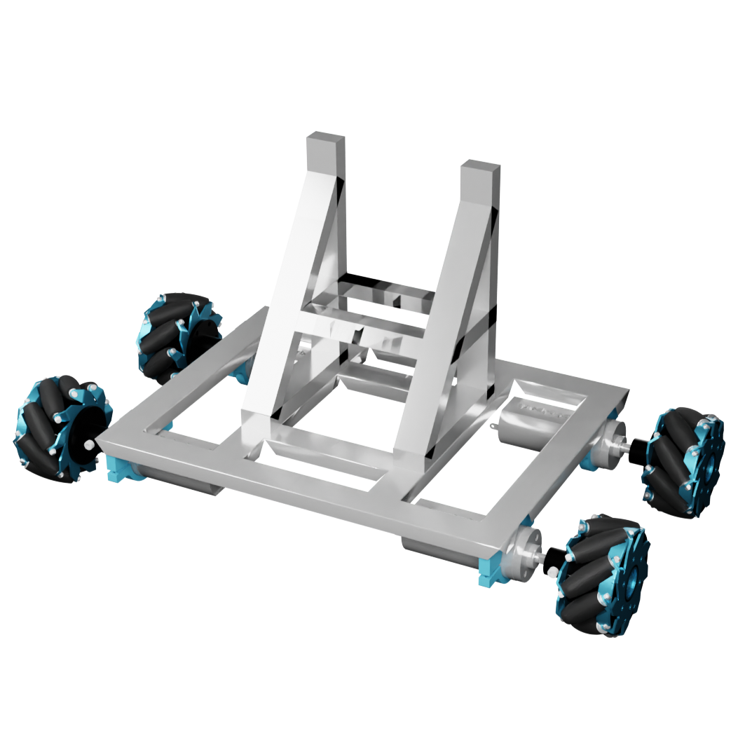
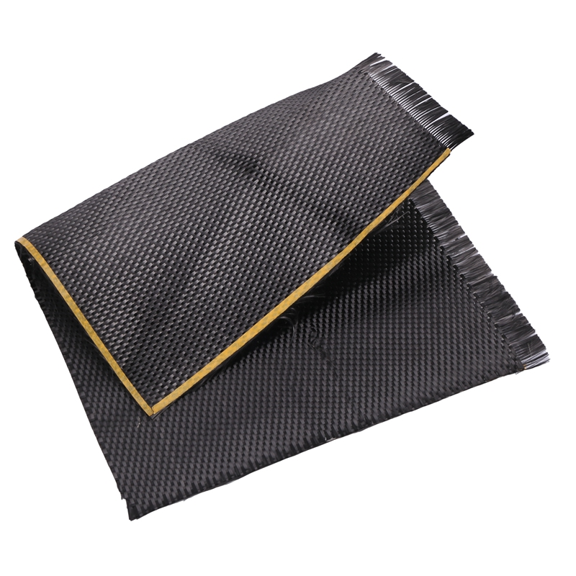
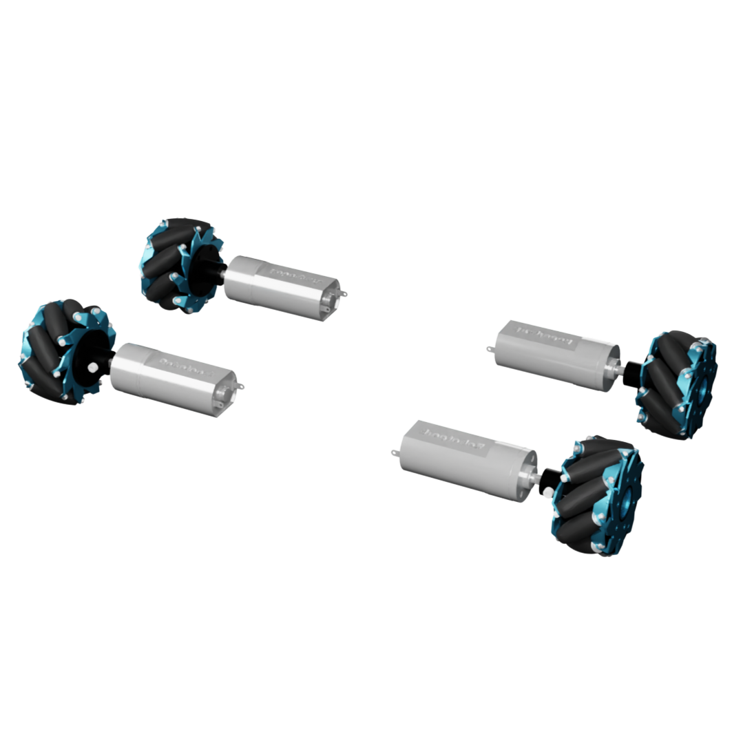
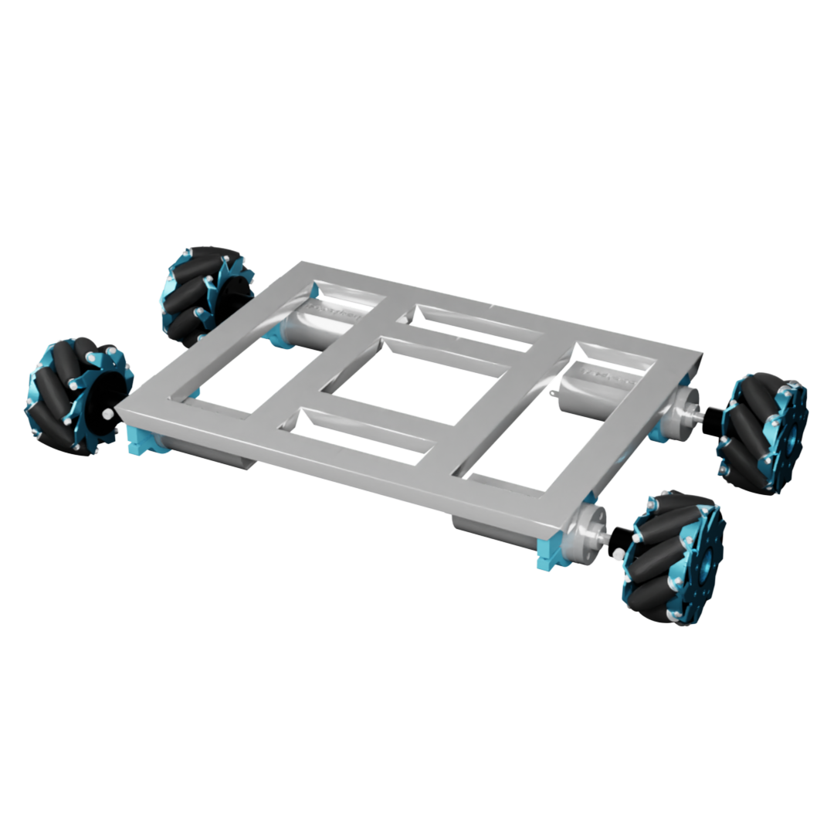
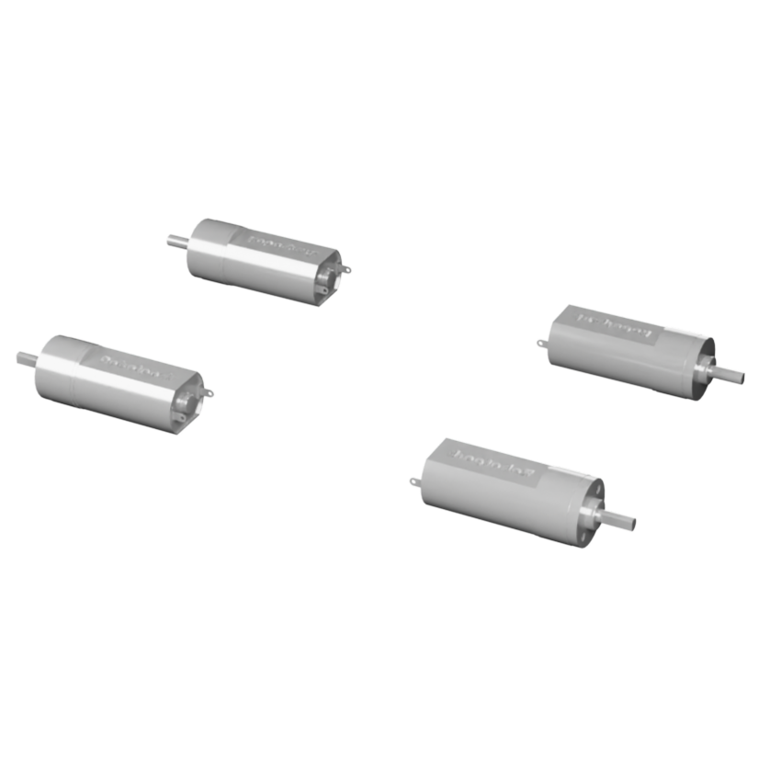
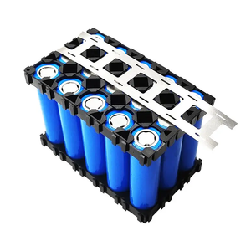
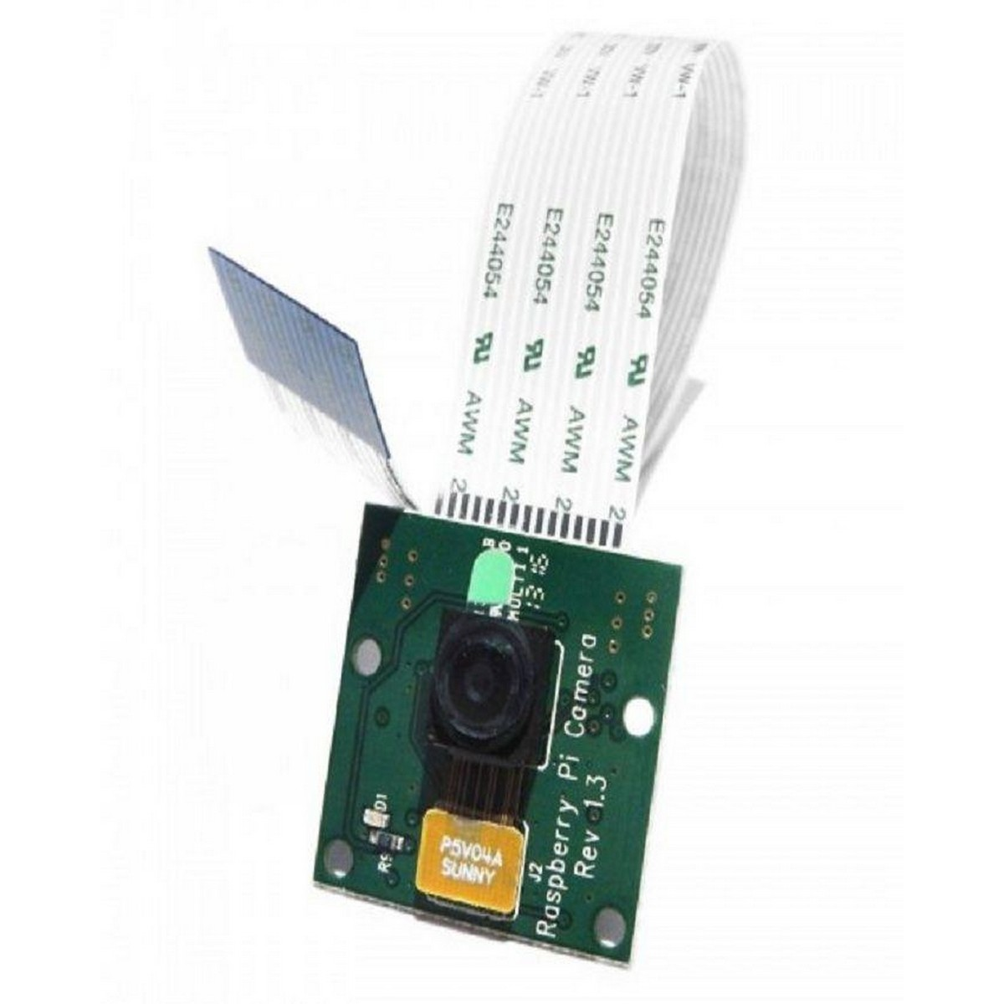
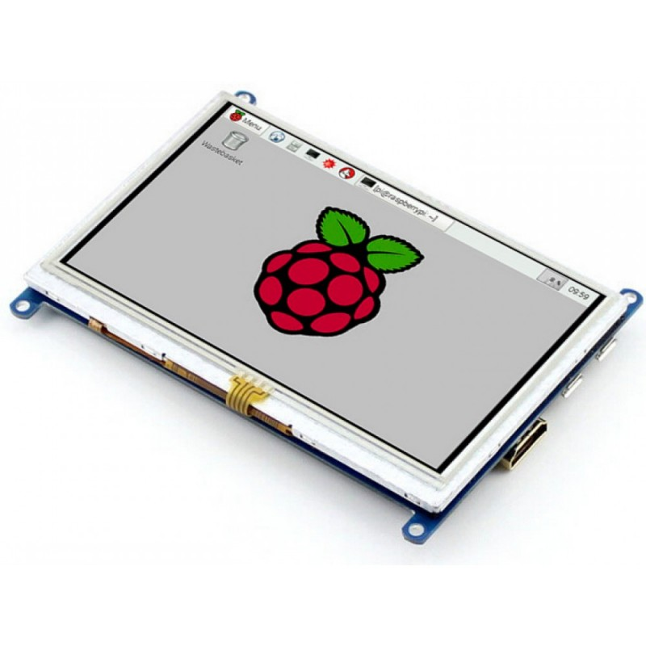
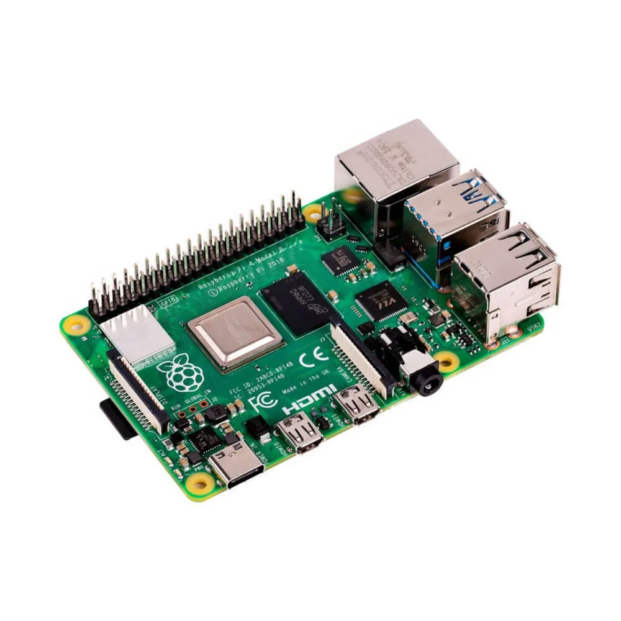
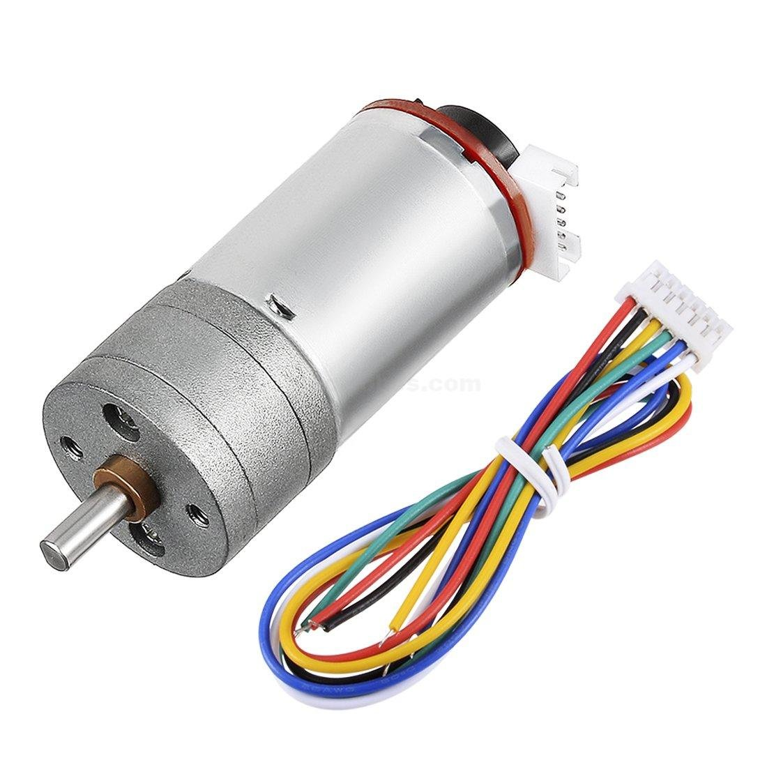
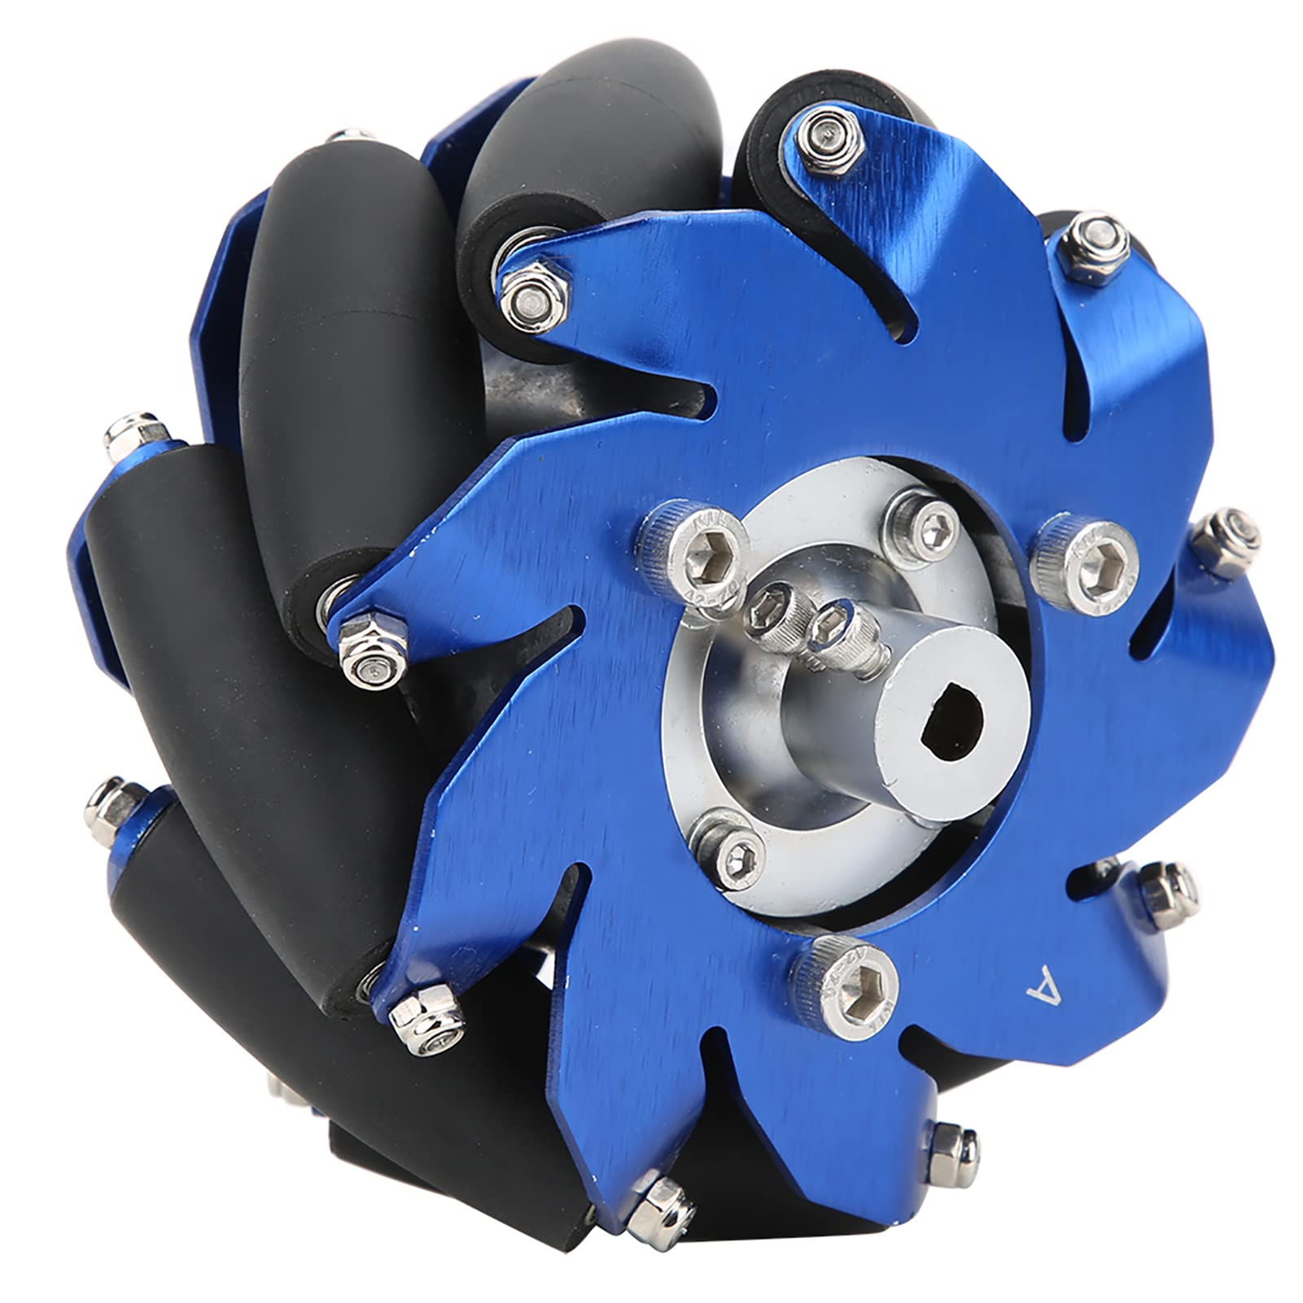
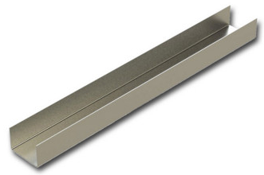
Hardware
Structure
Of alif
Lower Body
Torso
01
02
Face
Tyres
Chasis
Frame
Arms
Shell
04
Motors
03
Head
Limbs

Slide 22
Task Automation
Resume Screening and Analysis
- Automated parsing and evaluation of resumes using AI.
- Scoring candidates based on predefined criteria.
Conduct Interviews
- Conducting virtual or physical candidate interviews.
- Evaluating both technical and personality-based answers
Report Generation
- Creating comprehensive reports on recruitment outcomes
Functional Requirements

Slide 23
Interaction and Communication
Facial Expression Rendering
- Ability to display a range of human-like emotions for more
engaging interactions.
Voice Communication
- Support for natural language processing (NLP) to understand and
respond to spoken language in real-time.
Gesture Recognition
- Use of sensors to detect user gestures and respond appropriately.
Functional Requirements

Slide 24
Others
Mobility
- Ability to navigate workspaces autonomously.
- Obstacle detection and avoidance via sensors.
Learning and Adaptability
- Continuous improvement through ML/DL models for better task efficiency.
Decision Support
- AI-driven recommendations based on data patterns.
Functional Requirements

Slide 25
Resume Screening and Analysis
- Automated parsing and evaluation of resumes using AI.
- Scoring candidates based on predefined criteria.
Conduct Interviews
- Conducting virtual or physical candidate interviews.
- Evaluating both technical and personality-based answers
Report Generation
- Creating comprehensive reports on recruitment outcomes
Facial Expression Rendering
- Ability to display a range of human-like emotions for more
engaging interactions.
Voice Communication
- Support for natural language processing (NLP) to understand and
respond to spoken language in real-time.
Gesture Recognition
- Use of sensors to detect user gestures and respond appropriately.
Mobility
- Ability to navigate workspaces autonomously.
- Obstacle detection and avoidance via sensors.
Learning and Adaptability
- Continuous improvement through ML/DL models for better task efficiency.
Decision Support
- AI-driven recommendations based on data patterns.
Functional Requirements

Slide 26
Resume Screening and Analysis
Conduct Interviews
Report Generation
Facial Expression Rendering
Voice Communication
Gesture Recognition
Mobility
Learning and Adaptability
Decision Support
Functional Requirements

Slide 27
Performance/Speed
Scalability of Personalization
Accuracy of CV Screening
Ethical and Explainable AI in User Profiling
Environment Understanding Reliability
Efficiency in Task Execution
Non Functional Requirements

Slide 28



Tools &
Technologies
Python
Details go here
PHP
Details go here
MERN
Details go here

Slide 29
Conclusion

